Slide 1
Income Experiences
Heidi Aandahl
Enterprise Java, Spring 2019

Slide 2
Links!
Website link
Income Experiences
Demo link – purpose and function:
Income Experiences Demo on YouTube (8 min)
(Demo shows how to do CRUD and proves CRU… I promise D works too!)
Special topics:
Hibernate Search (with Filter) Code on YouTube (3 min)
Chart.js Code on YouTube (3 min)

Slide 3
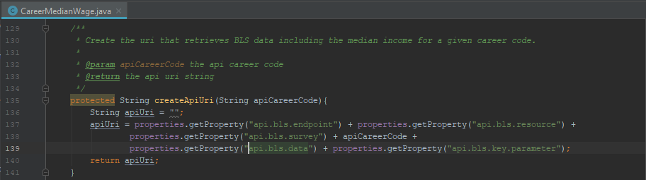
Bureau of Labor Statistics API
Example of a request for web developer data, without an api key:
https://api.bls.gov/publicAPI/v2/timeseries/data/OEUN000000000000015113413

Slide 4
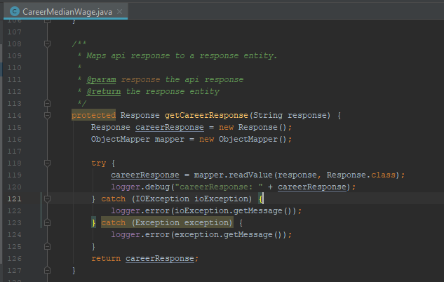
Logging
Mainly for exception handling
Some debugging (often deleted)

Slide 5
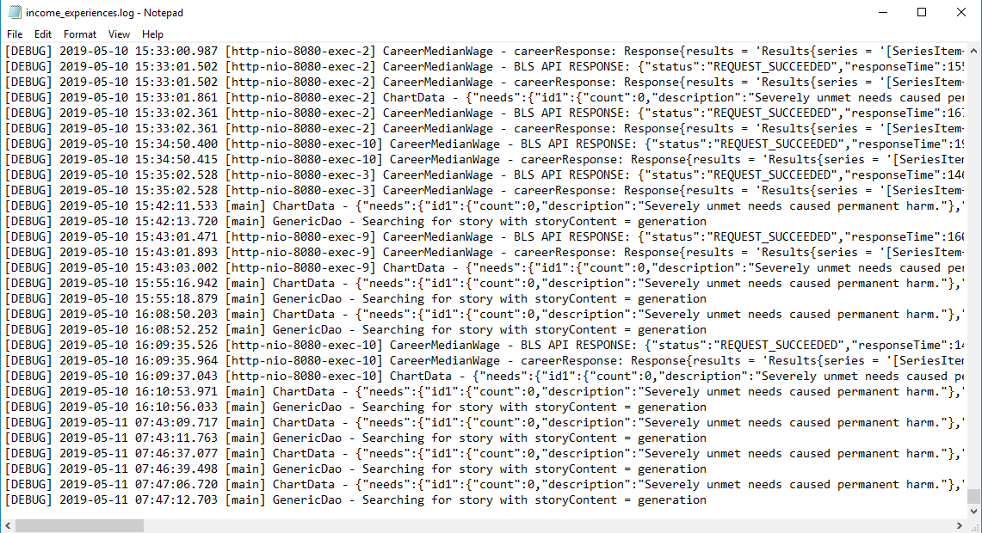
Recent Logging of Application

Slide 6
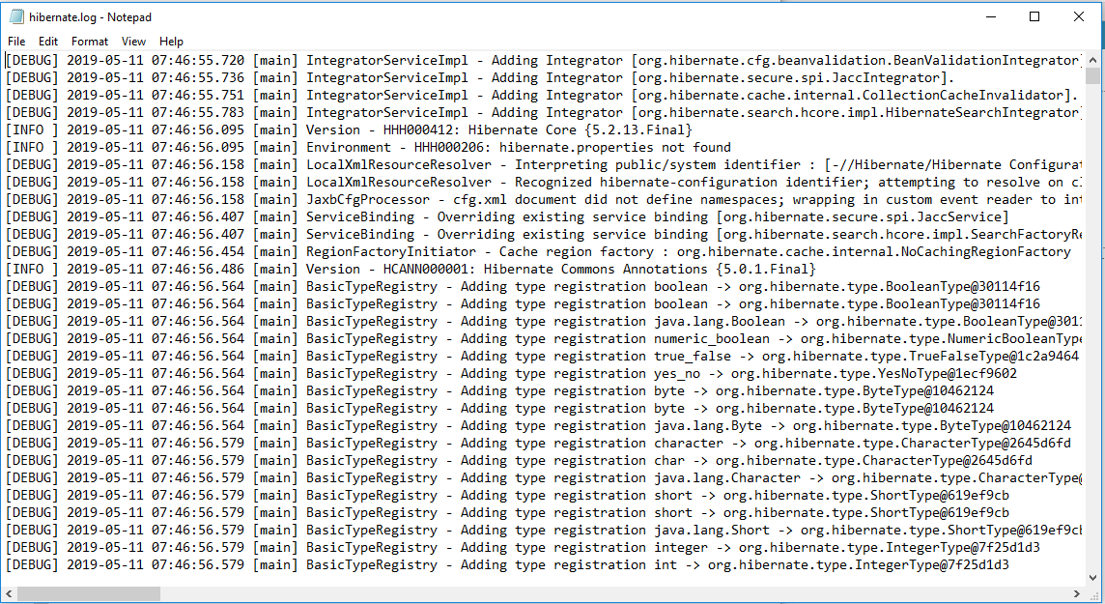
Recent Hibernate Log

Slide 7
Hibernate Search
Why: to be able to search the text of stories by topic
How: Hibernate Search Video (3 min)
References for Independent Research:
Hibernate Search Reference Guide https://docs.jboss.org/hibernate/search/5.9/reference/en-US/pdf/hibernate_search_reference.pdf
Hardy Ferentschik “Hibernate Search talk” https://www.youtube.com/watch?v=qPLY9PYv_8g

Slide 8
Chart.js
Why: to give users a quick visual to understand other users’ data
How: Chart.js Video (3 min)
References for Independent Research:
Chart.js website https://www.chartjs.org/
Post by Joseph Kulandai on using Chart.js with Java https://javapapers.com/ajax/getting-started-with-ajax-using-java/

Slide 9
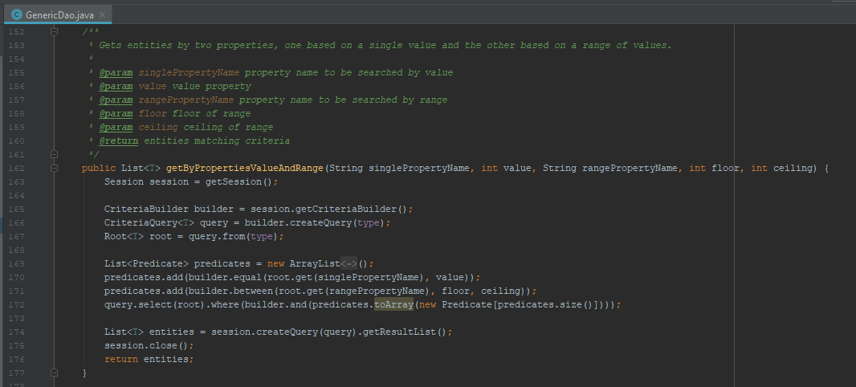
Something unique: DAO method to get values within a range

Slide 10
Testing Approach
Deploy and see if pages talk to each other
Unit testing
DAO – thorough, learned to use through testing
API – initially used unit test to retrieve api data and figure out how to work with it
Some testing-while-coding
Some saved until the end… and beyond

Slide 11
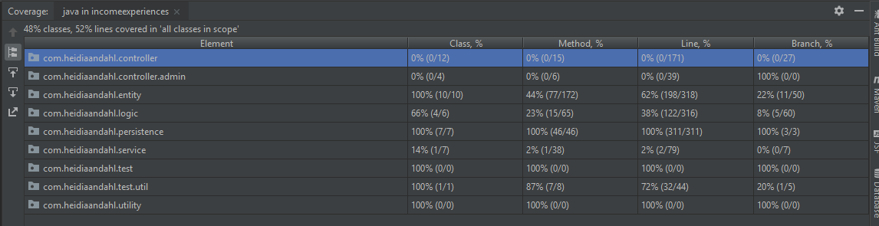
Testing Coverage

Slide 12
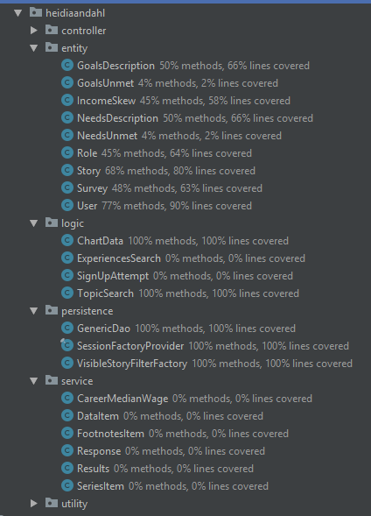
Testing Coverage

Slide 13
Lessons Learned
Love
My charts! -- This is my first project integrating Java and JavaScript!
Data! -- I got to know Hibernate well and made good use of it.
Change
Use project Lombok
BRUTAL MINIMALISM for MVP scope, leaving more time for…
Using a superclass for similar classes to avoid repeated code
More refactoring and unit testing
Eliminating abandoned code (that I’m currently afraid to delete)

Slide 14
Version 2 Would…
Validate the length of a new financial story and provide a button allowing a user to hide their story without writing a new one
Link to a contributor’s profile wherever their financial story is presented
Let users do a fuzzy search for stories
Show commas in the dollar amounts

